Slide 1
Aakash Murali

Slide 2
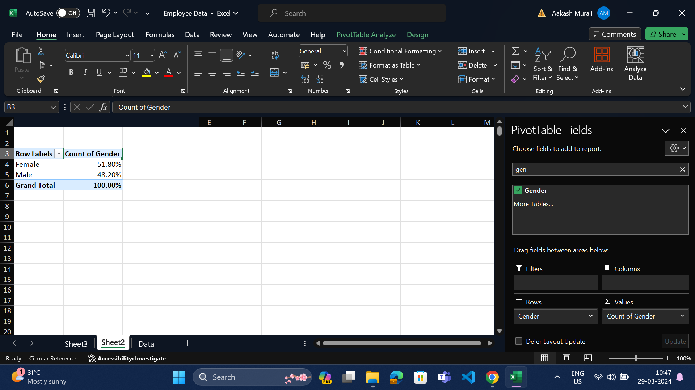
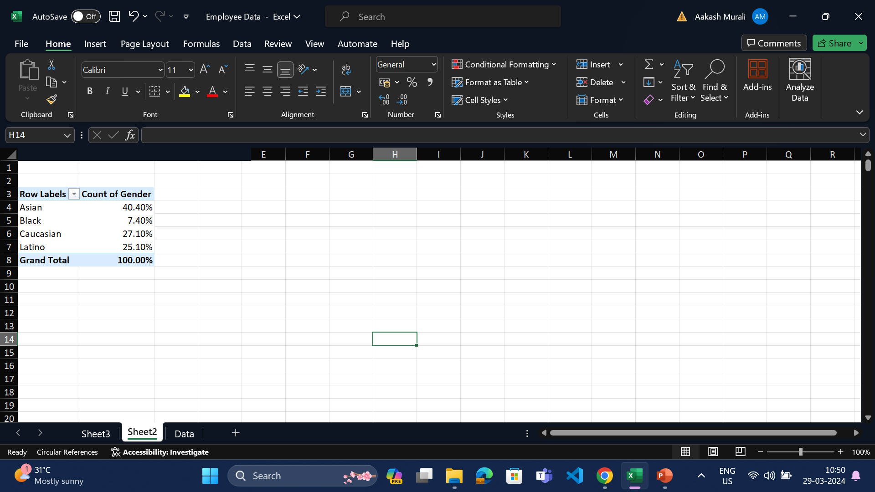
1)Summary of gender and ethnicity distribution within the company
After filtering the % of employees based on gender and ethnicity it is observed that the distribution of the company is diverse.

Slide 3
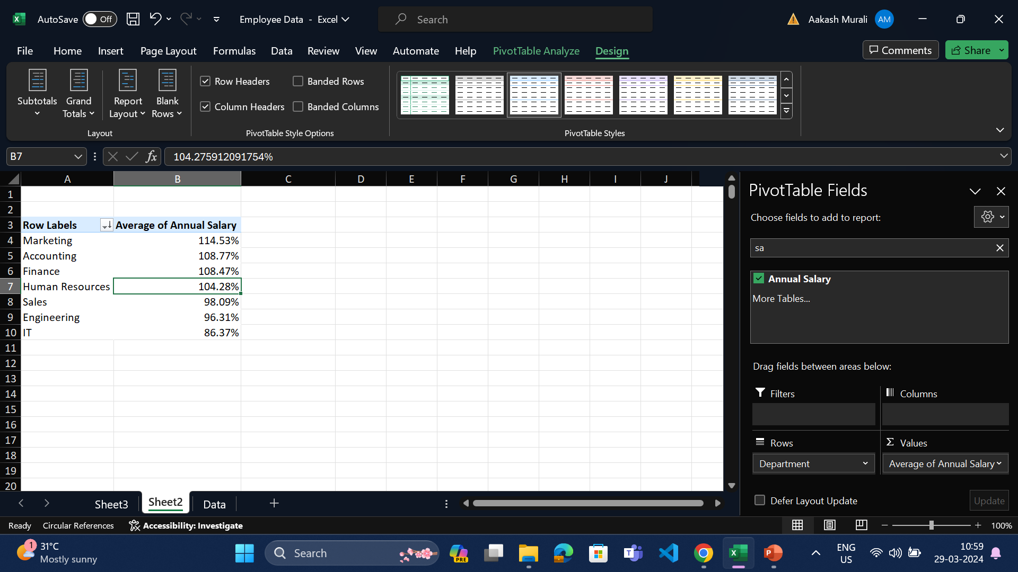
3)Is there a significant difference in avg salaries btwn diff depts?
After findind the sum and avg% of salaries of diff departments , it is noted that there is difference among the depts , with marketing getting almost 30% more than IT in terms of avg% even though the sum of salary is greater for IT.

Slide 4
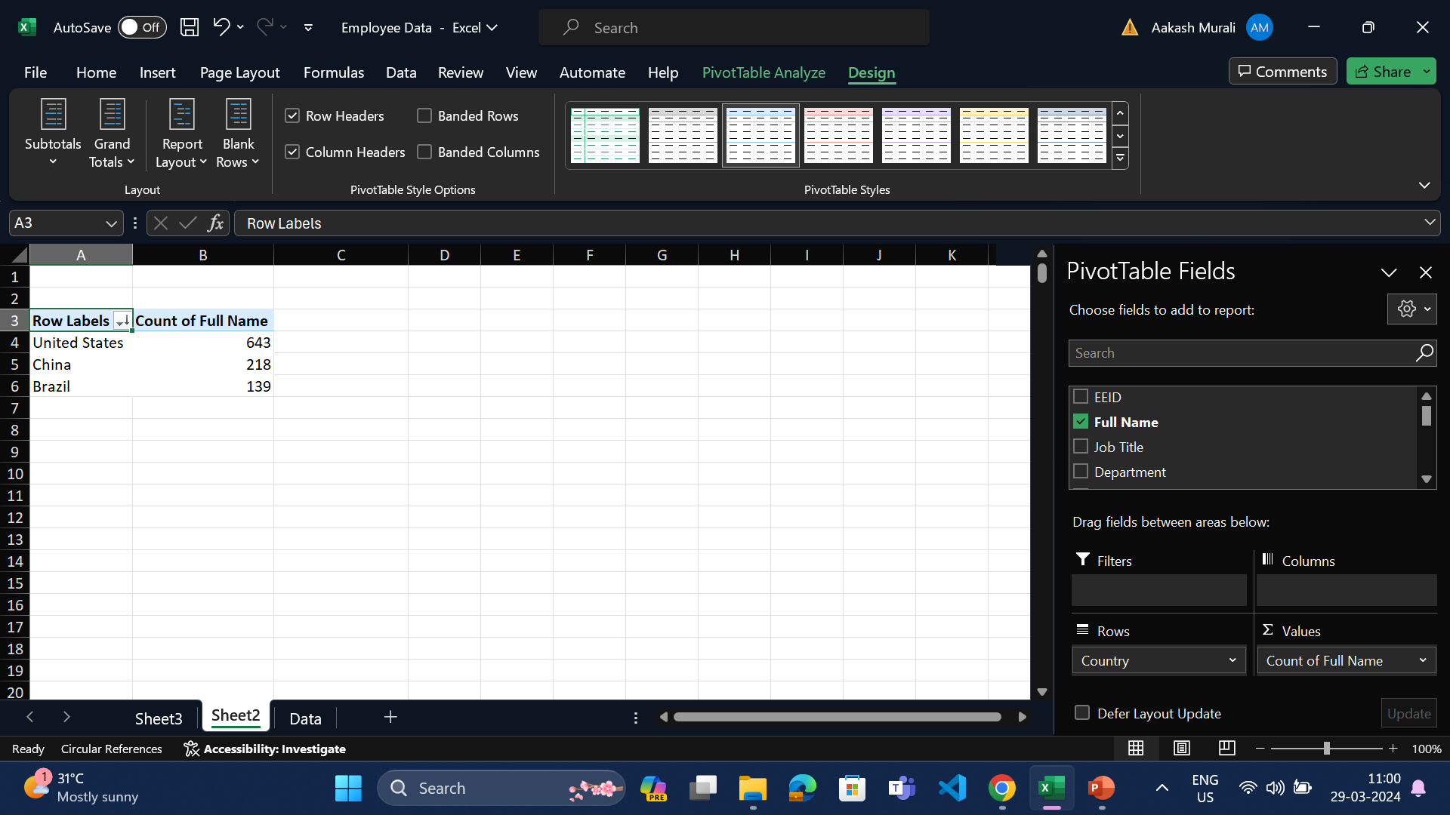
4)Which country has the highest number of employees
From the below fitering and sorting , it is noted that united states has the higher number of employees that the rest of the countries.

Slide 5
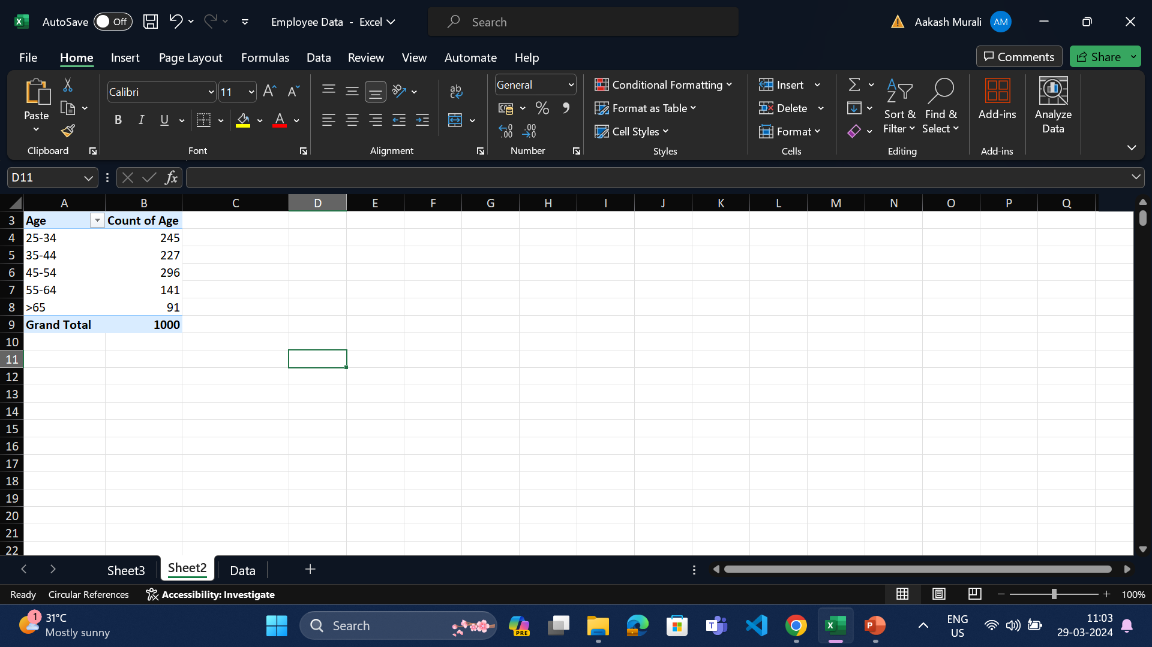
5)Common age range btw employees
After finding the common range of employees by forming a age group , it is noted that even though not by large , still people with age range 45-54 Is the most common age range within the company.

Slide 6
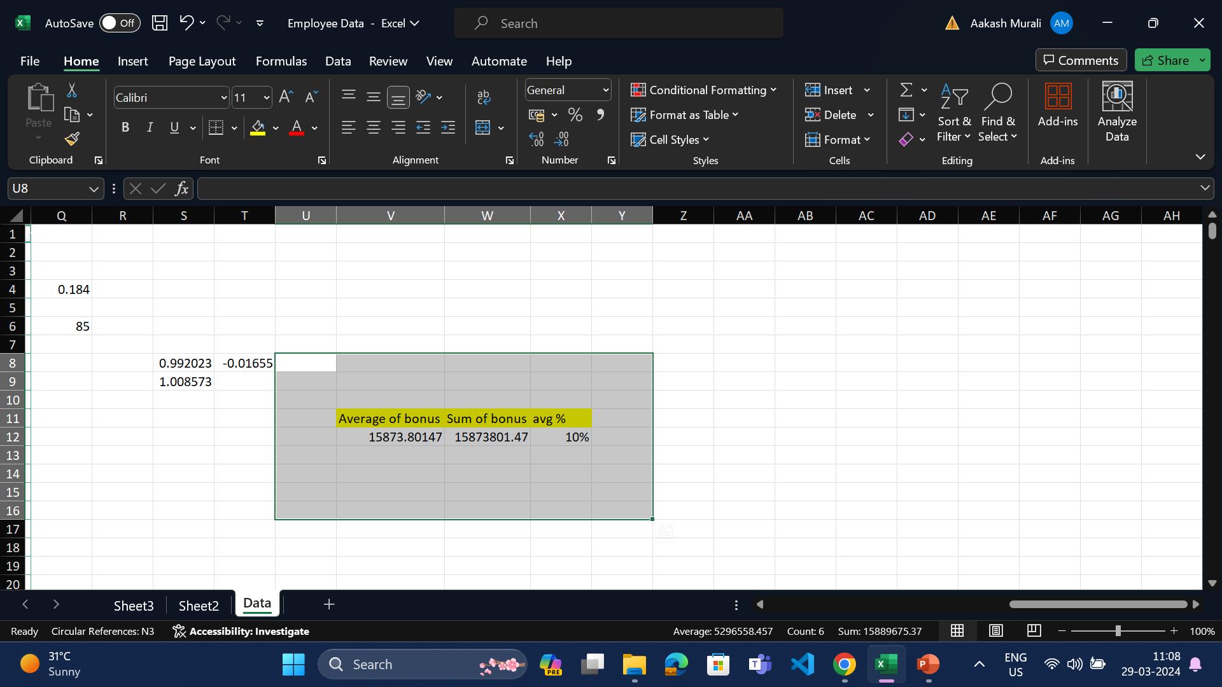
6)Avg bonus % given to employees
After finding the sum and avg of bonus ,the avg% of bonus is found to be 10%.

Slide 7
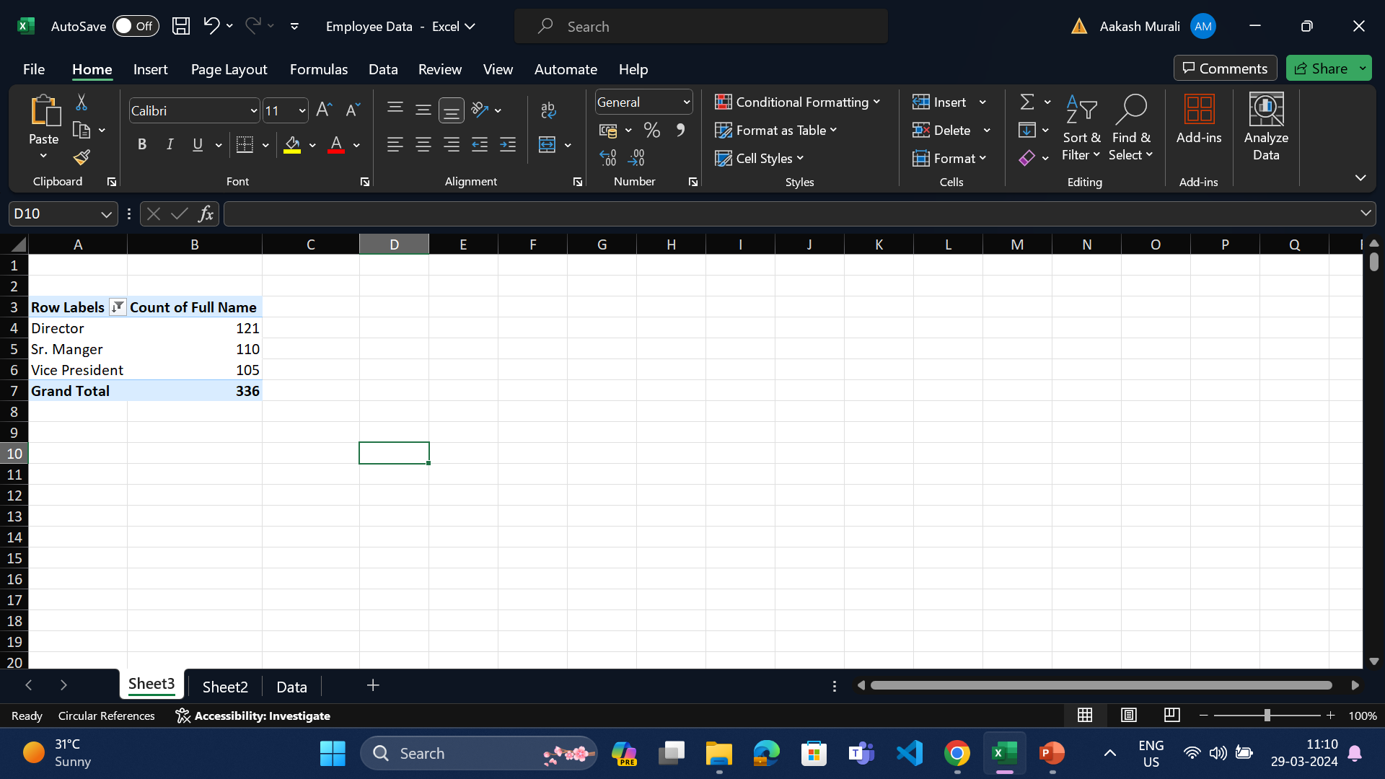
7) Which job title occurs most frequently in dataset
The job title of Director occurs most frequently in the dataset , which is found after filtering ,sorting the respective fields.

Slide 8
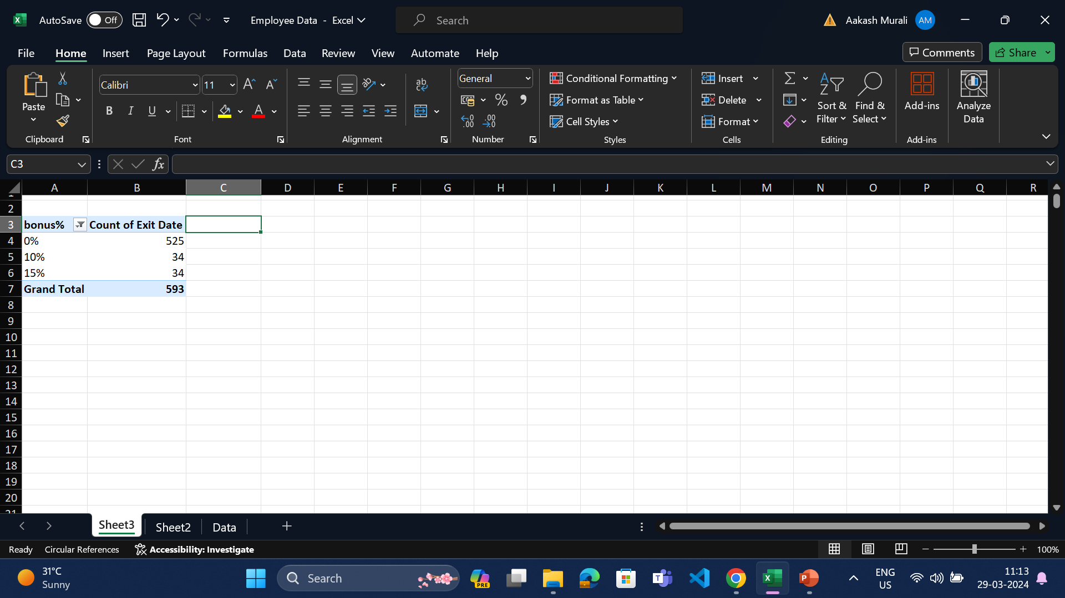
8)What are primary reasons citied for mployee exits
After filtering and sorting , it is found that employees with the 0% bonus have left the company and that is the most common reason

Slide 9
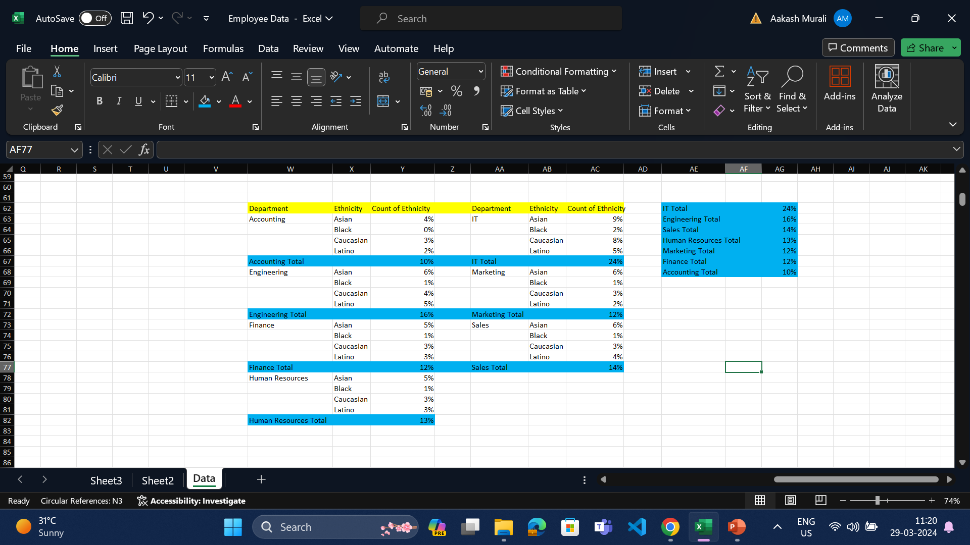
9)Are certain depts more diverse in terms of ethnicity than others?
After filtering the table and finding the individual depts ethniticity it is found that there is diversity in some depts than the others like the it is 14% more than accounting.

Slide 10
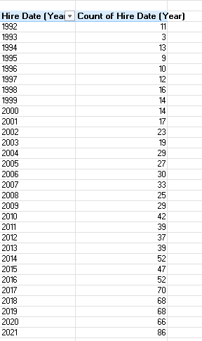
10)Has there been a increase or descrease of hires in the past few years?
Yes , in the past few years , there has been more hiring than the prev years.

